Slide 1
Faults in Deep Reinforcement Learning Programs A Taxonomy and A Detection Approach 2021
Presented by : Mayuresh Nene, Prasad Chavan, Ryan Chui

Slide 2

Agenda
Introduction
Key definitions
Problem
Solution
Meta Model for DQN
Experimental Design and Result
Research Validation

Slide 3
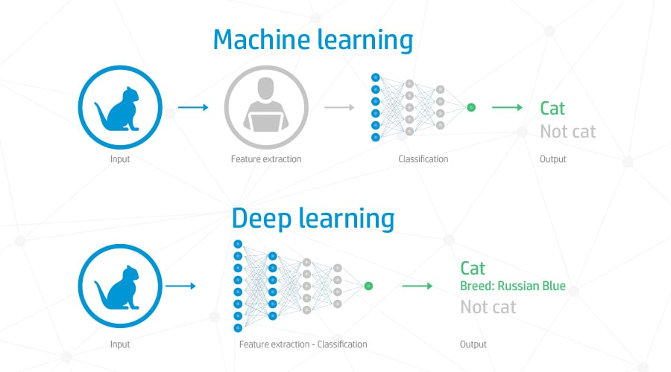
What is Deep Learning?

Slide 4
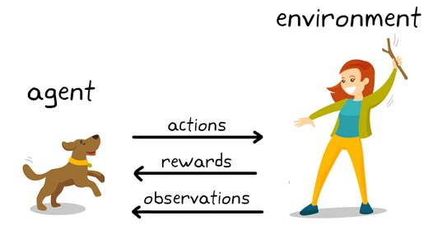
What about Reinforcement Learning?

Slide 5
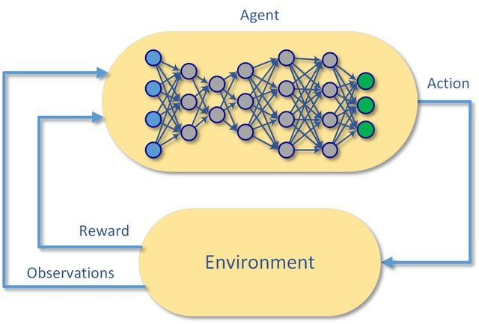
Deep Reinforcement Learning (DRL) Systems

Slide 6
Deep Reinforcement Learning (DRL) Systems
Deep Reinforcement Learning tries to solve problems that require dynamic sequential decision making.
Agent Exploration/Exploitation tradeoff balancing.
- Decide whether to go for decision with known high yield or to explore a new decision which may or may not have a higher yield.
- They usually collect data with a stochastic policy.
Idea to promote exploration is giving the agent a motive to explore unknown outcomes.
- Generally done by incentivising exploration by modifying the loss function.

Slide 7
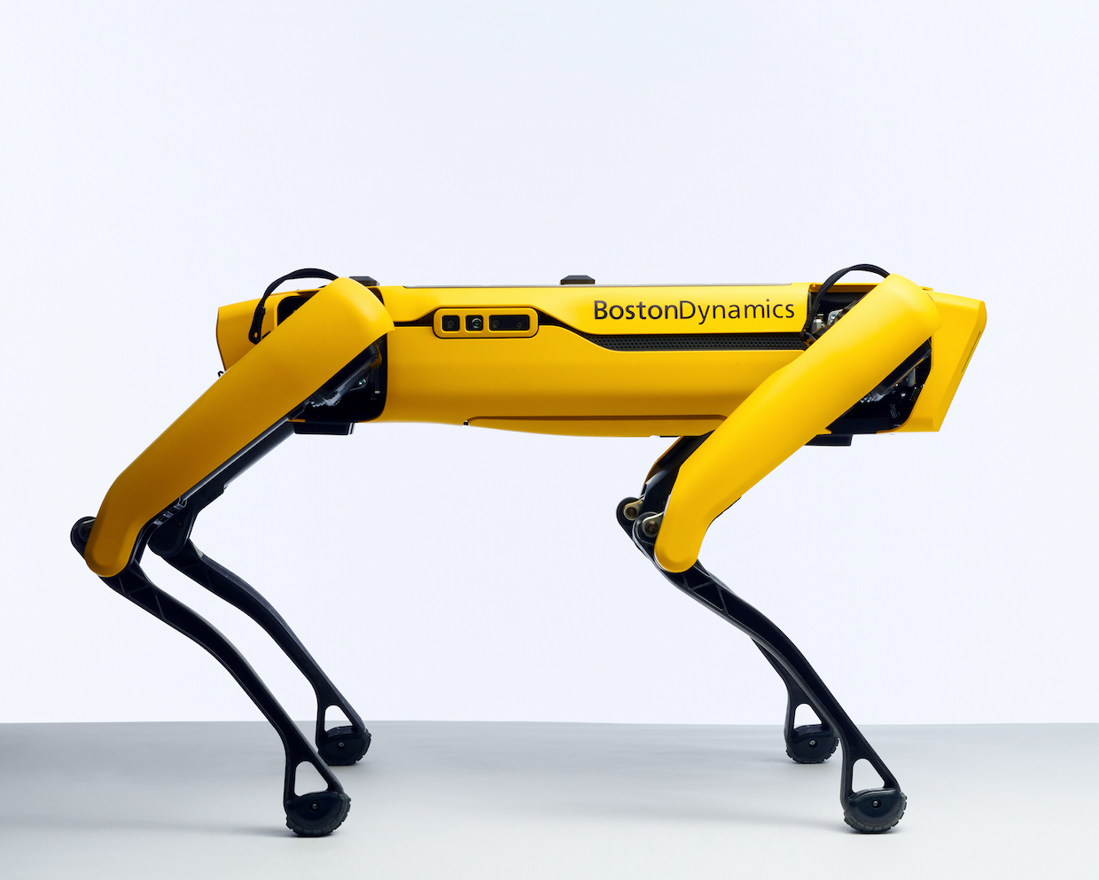
Applications of Deep Reinforcement Learning
Automobile industry :
Autonomous Cars
Intelligent Braking Systems
Healthcare :
Automated Diagnosis
Chronic disease treatments
Robotics :
Manufacturing (Assembly lines)
Combat Training

Slide 8
Why go for DRL and not RL Systems?
Example of a video game :
A reinforcement learning model can keep track of all the (state, action) pairs.
Maintaining all these pairs is possible in case of a 2D game such as Pacman.
In case of bigger games, even a slightly changed state is still a distinct state. It becomes infeasible for an RL to keep track of all (state, action) pairs.
You could use something that can generalize the knowledge instead of storing and looking up every little distinct state.
This is where a DL neural network comes into the picture which can predict the reward for an input (state, action) pair or or pick the best action given a state, however you like to look at it.

Slide 9


Slide 10
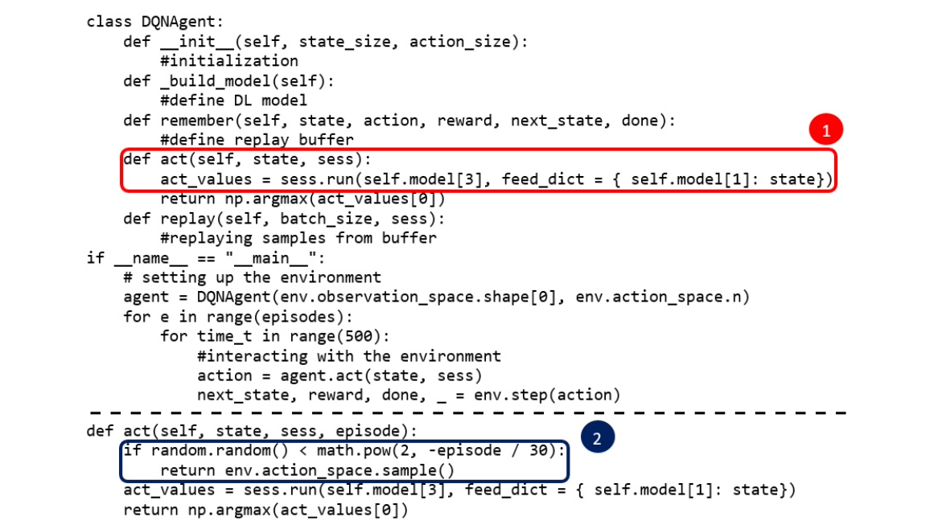
Faults in DRL Systems
Cartpole was stuck at a suboptimal reward level without further improvements.
Missing random actions implementation.
Agent fails to perform random actions to gather information from the environment.

Slide 11


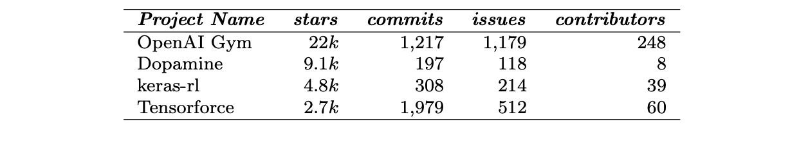
Mining the required data

Slide 12
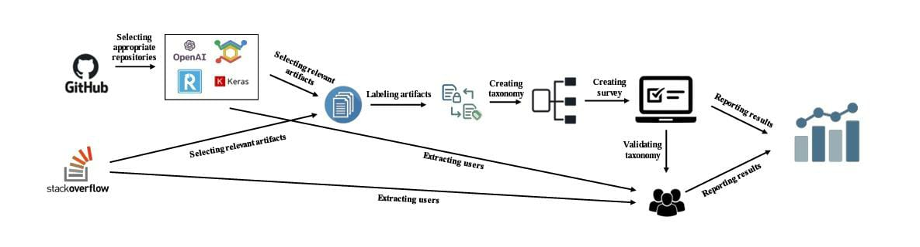
Methodology of Obtaining the Taxonomy
Steps to build the taxonomy
Manual Analysis of the DRL Programs
Building and Validating the taxonomy

Slide 13
Manual Analysis
Data was mined from Github and Stack Overflow posts
Stack Overflow:
Yielded 2072 posts
After filtration: 329 posts
Github:
Extracted all issues from the 4 libraries
Filtered by label as ‘closed’
OpenAI Gym | Keras-RL | TensorForce | Dopamine
151 | 200 | 300 | 110

Slide 14
Manual Analysis
Manual labeling was performed
Criteria to reject a artifact from analysis:
Not related to the bug fixing activity
Related to an issue with the framework itself
Common errors
Root cause wasn’t clear for the authors

Slide 15

Building Taxonomy
Bottom up approach used:
Labels Categories
Double check each category
Subcategories Parent Categories
Explore all categories, subcategories and leaf nodes
Finalize the taxonomy

Slide 16
Validating Taxonomy
Survey involving DRL practitioners was used to validate
The practitioners were selected from Github and Stack Overflow
A total of 210 practitioners were selected
140 from Github
40 from Stack Overflow
19 practitioners responded to the survey
8 researchers
11 developers
Experience of the practitioners (in years):
ML & DL DRL
Least 1 to 3 Less than 1
Median 3 to 5 1 to 3
Most 5 + 5+

Slide 17
DRL Faults
5 Main Categories
Model
Model type and properties
Layers
Tensors and Inputs
Wrong tensor shape
Wrong input
GPU Usage
Training
Hyperparameter selection fault
Loss function and Optimizer faults
Application Programming Interface

Slide 18
Taxonomy Obtained
DRL Faults
Interacting with the Environment
Exploring the Environment
Updating the network
Output
Missing stepping the environment
Terminating the environment
Missing exploration
Suboptimal exploration rate
Wrong update rule
Suboptimal network update frequency
Wrong network update
Wrong calculation of gradients
Wrong output
Wrong activation for output
Missing terminal state
Missing reset / close of environment

Slide 19
Interacting with the Environment
Type 1: Missing stepping the environment:
Failure to move the environment to a new state
Type 2: Missing terminal state:
Wrong detection of the terminal state
Completely missing the terminal state
Type 3: Missing reset / close environment:
Bad termination problems
}
Faults while terminating the environment

Slide 20

Exploring the Environment
Type 4: Missing exploration:
Failure to explore the environment while in a new state
Type 5: Suboptimal exploration rate:
Problems related to exploration parameters
For example the Epsilon in Epsilon greedy method

Slide 21
Updating Network
Type 6: Wrong update rule:
Incorrect update rule for a value or policy function
Type 7: Suboptimal network update frequency:
Network frequency update parameters cause issues if not properly calibrated
Type 8: Wrong network update:
Wrong update of the parameters of the network
Wrong update of the network itself
Type 9: Wrong calculation of gradients:
Gradients of learning

Slide 22
Output
Type 10: Wrong output:
Failure to define a correct output layer
Type 11: Wrong activation:
Failure to define a correct activation function for output

Slide 23
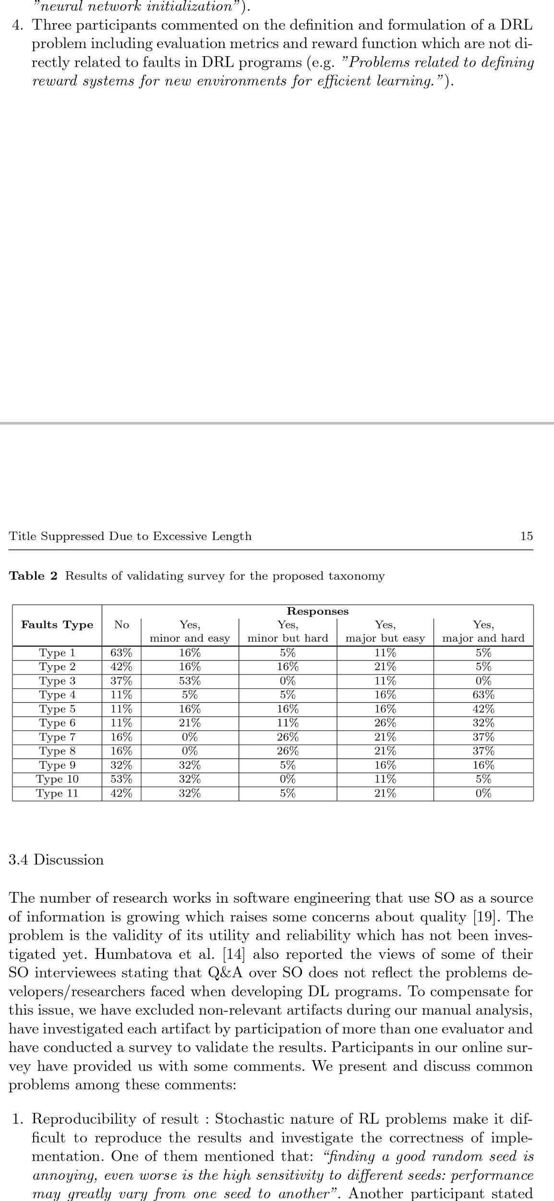
Validating Results

Slide 24
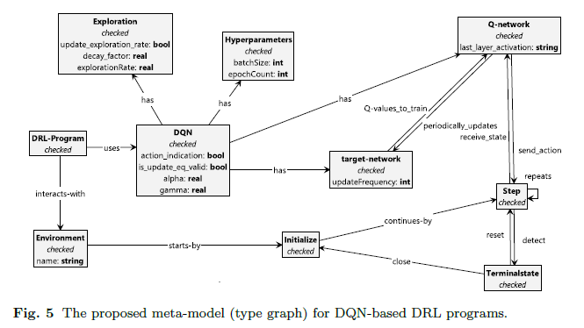
Meta Model
Let’s consider the meta model for a DQN
Environment:
Variables for
number of actions and
number of states
Deep Q-Network:
The decision making component

Slide 25
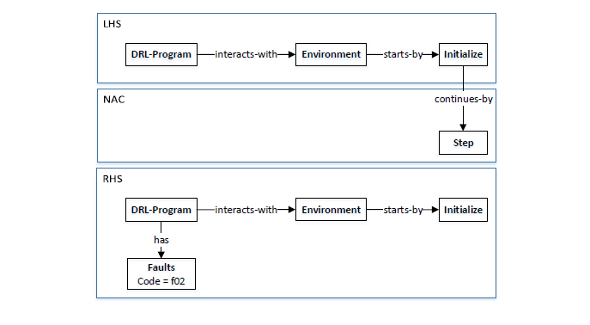
Detect Faults by Graph Transformation
Two ways to build a DRL Program
Configure an arbitrary model directly.
Transform a DRL program to a model.
LHS shows DRL-program with its initialized Environment.
The fault is detected if there is not a Step node just after Initialize.
NAC forbids the existence of Step right after Initialize. Thus, if the fault is detected, RHS adds a Faults node with relevant fault code to the DRL-program.

Slide 26
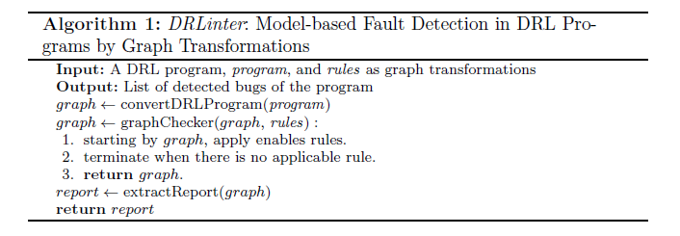
Implementation
In ConvertDRLProgram step, the source code is parsed to extract relevant information in order to build the model.
Once the DL source code is modeled as a graph, by calling graphChecker, the detection rules can be used to execute the sequence of graph transformations on the model.
Current version of DRLinter are developed on OpenAI Gym and TensorFlow libraries in order for synthetic DRL programs to work.
By calling extractReport, a report will be extracted from the output of graphChecker.

Slide 27
Experimental Design
Need some buggy DRL codes that contain the types of faults covered in DRLinter.
Evaluate DRLinter using some synthetic faulty DRL programs that are created by reproducing real DRL faults.
Use StackOverflow and Github as a platform for DRL faulty program to construct taxonomy to synthesize buggy examples.
Step 1: Run a DRL programing using OpenAI Gym or Tensorflow.
Step 2: Injected the fault type to the code.
Step 3: If observed pattern of faults is found, they will be used to reproduce synthetic faulty samples for future use. Note that at least one faulty example will be executed at least once during detection rule process.

Slide 28
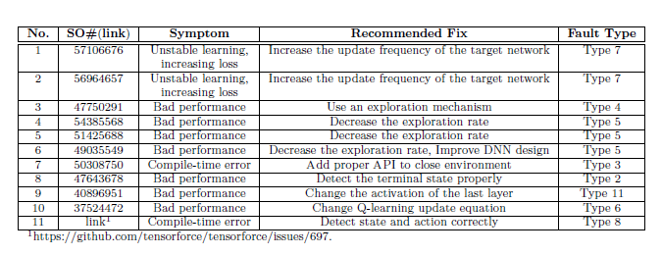
Experimental Sample Result
DL interface can detect the bugs in all 15 synthetic examples, but failed to detect all existing faults in the programs.

Slide 29
Research Validation
Two ways to validate taxonomy of real faults.
a) Manual Analysis of Github artifacts and StackOverflow posts.
b) Conducted survey with developers/ ML researchers to verify completeness
and usefulness of identified faulty type categories.
Pros and Cons discussion.

Slide 30
ANY QUESTIONS ??

